Slide 1
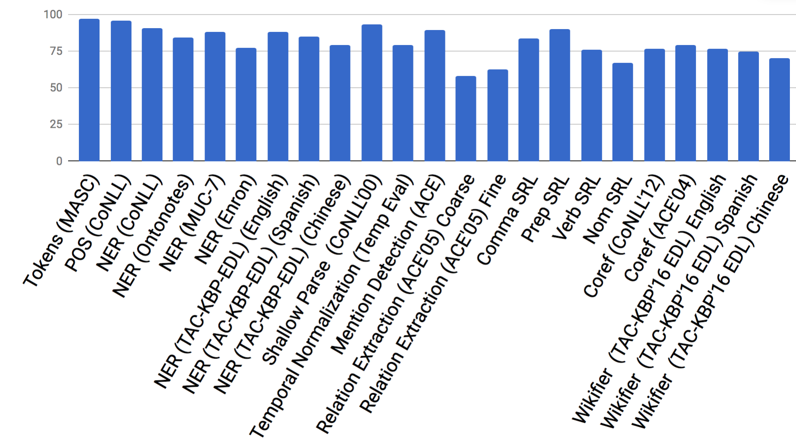
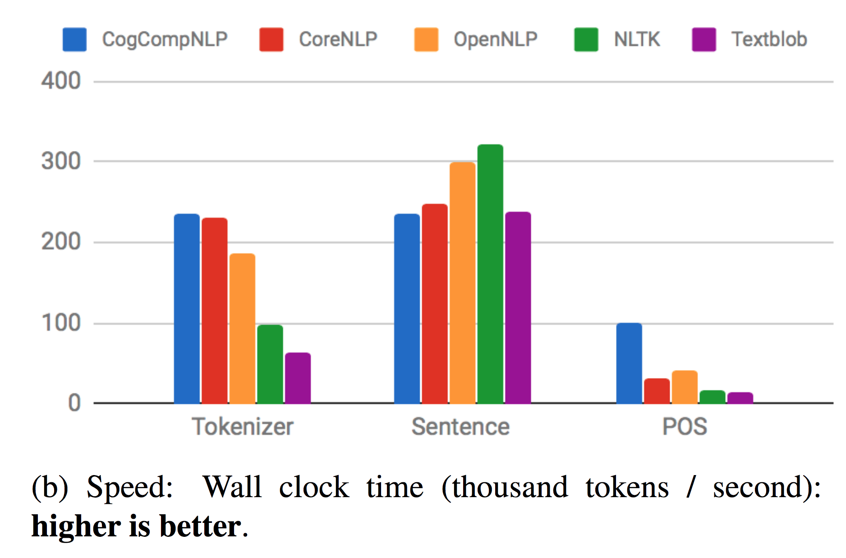
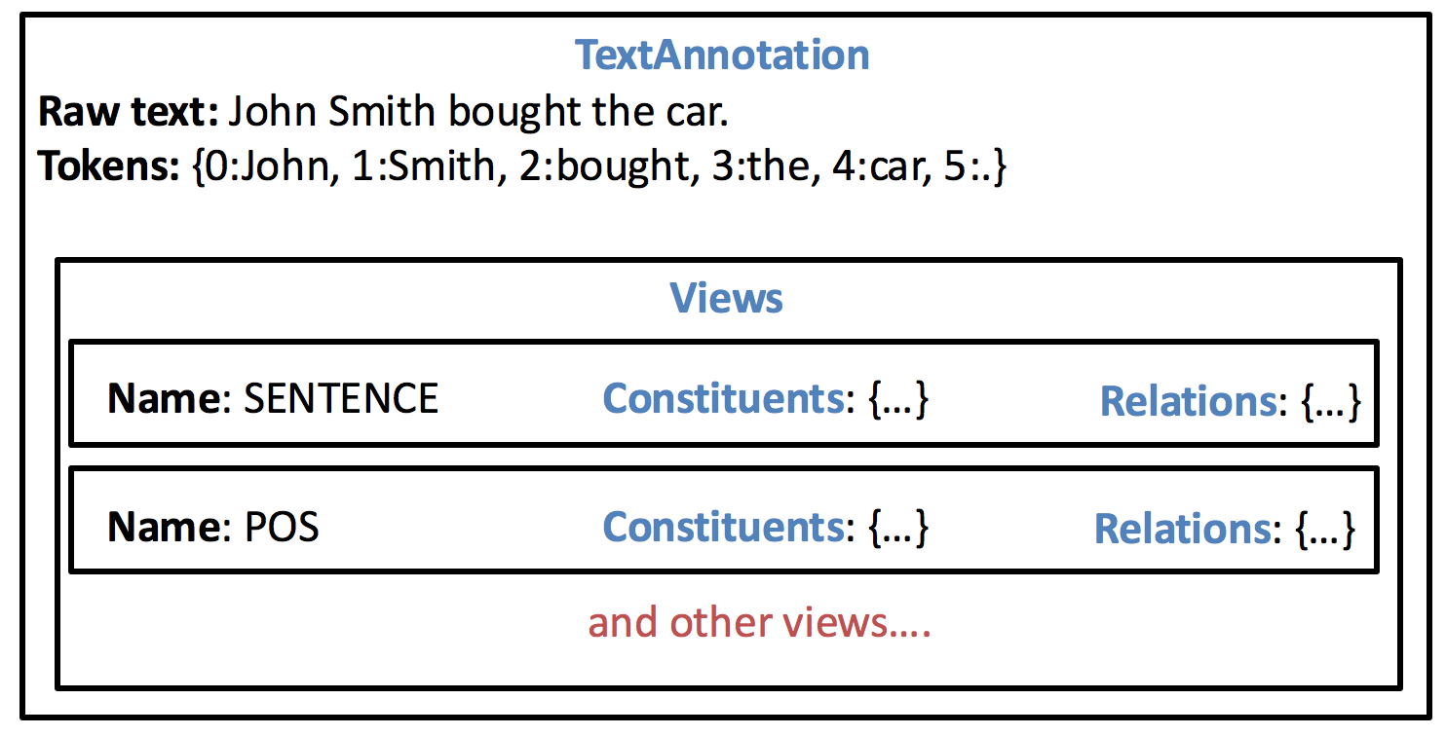
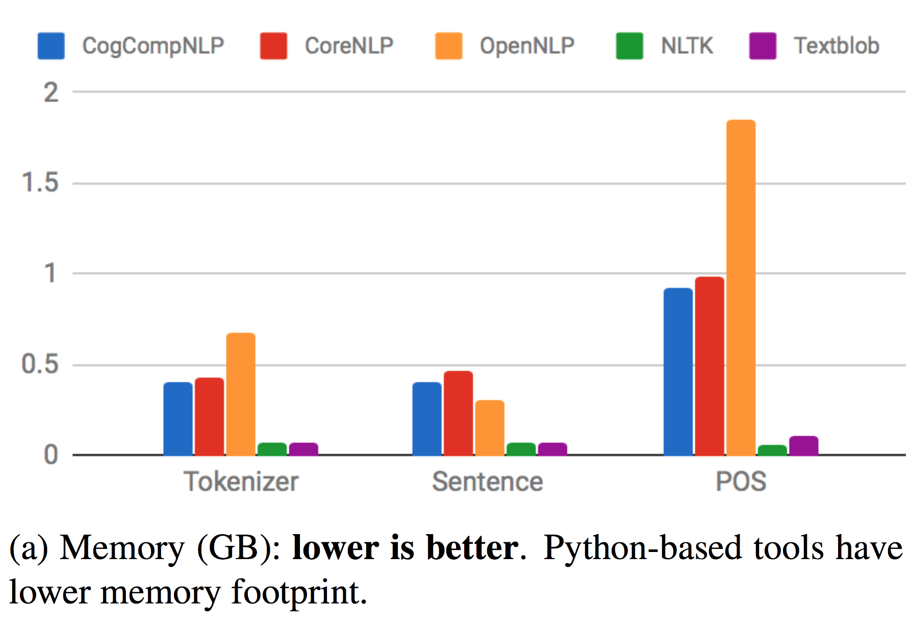
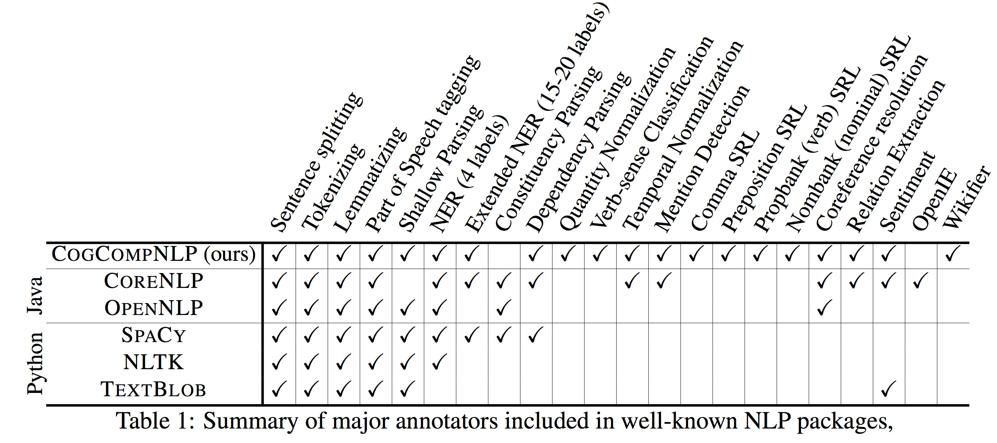
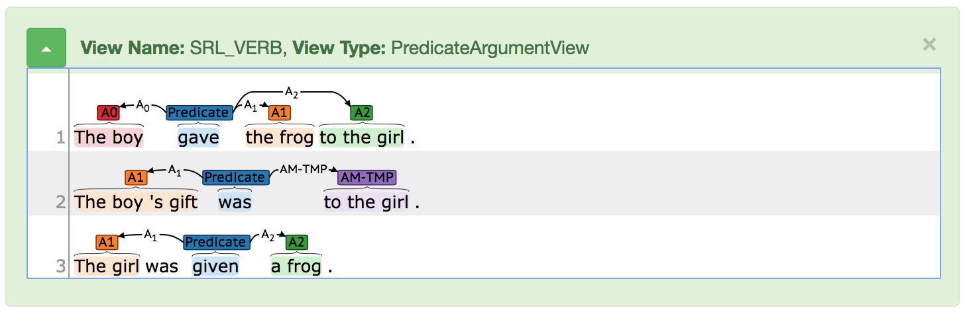
CogCompNLP: Your Swiss Army Knife for NLP
Daniel Khashabi, Mark Sammons, Ben Zhou, Tom Redman, Christos Christodoulopoulos, Vivek Srikumar, Nicholas Rizzolo,
Lev Ratinov, Guanheng Luo, Quang Do, Chen-Tse Tsai Subhro Roy, Stephen Mayhew, Zhili Feng, John Wieting, Xiaodong Yu,
Yangqiu Song, Shashank Gupta, Shyam Upadhyay, Naveen Arivazhagan, Qiang Ning, Shaoshi Ling, Dan Roth
Motivation
Components
Quantitative Evaluation
Supporting Natural Language Understanding applications requires preprocessing text at multiple, syntactic and semantic, levels.
We call each preprocessing level –from Tokenization to POS tagging, to Semantic Role Labeling, etc–a Text Annotator.
The process of managing and aggregating annotations is labor-intensive and error prone, requiring significant engineering.
It is essential to building software frameworks for easy access to a wide range of NLP annotators and for straightforward use.
Edison
A qualitative assessment of the major components show that they have state-of-the-art quality or very close to the best existing results.
A feature extraction framework that extract features to be used by machine learning algorithms. It enables users to define feature extraction functions that take as input the Views and Constituents created by Annotators.
Core-Utilities
Corpus-Readers
Fundamental data-structures and operators; hence many of the other modules depend on it:
• SQL-like operations on Text-Annotation
• Experiment utilities & statistical significance
• String pattern-matching algorithms
• Utilities for reading and writing annotations.
The corpus reader module includes NLP corpus readers that populate Text-Annotation objects. A few important datasets supported:
• Treebank Shallow Parse
• PennTreebank Constituency Parse
• ACE 2004/2005
Ontonotes 5.0
Basic Data-Structures
A Text-Annotation contains the raw source text with its tokenization and other annotation layers
A View is a data structure which contains an annotation structure of a text.
An Annotator is a class which produces a View given a text, and potentially some other Views.
Pipeline
Similarity Utilities
Speed and memory comparison between major NLP pipelines:
Provides a simple interface to access Annotator components either individually or as a group.
For calculating semantic similarity between words (e.g. Word2Vec, ESA, etc), phrases, and entities.
Java code: https://github.com/CogComp/cogcomp-nlp
Python code: https://github.com/CogComp/cogcomp-nlpy
Java Python
// ’ta' is a partially annotated text
TextAnnotation ta = ...
AnnotatorService pipeline = PipelineFactory.buildPipeline(ViewNames.POS, ViewNames.NER_CONLL);
TextAnnotation augTa = pipeline.annotateTextAnnotation(ta); System.out.println(augTa.getView(ViewNames.POS).getConstituents());
// (NNP Pierre) (NNP Vinken) (, ,) (CD 61) (NNS years)...
from ccg_nlpy import remote_pipeline
pipeline = remote_pipeline.RemotePipeline()
text = "Hello, how are you. I am doing fine"
ta = pipeline.doc(text)
print(ta.get_pos)
# (UH Hello) (, ,) (WRB how) (VBP are) ...
Speed: Wall clock time (thousand tokens / second); higher is better.
Link to demos: http://nlp.cogcomp.org
Memory (GB); lower is better.
Acknowledgements
Partly based on research sponsored by
DARPA under agreement number FA8750-13-2- 0008.
Contract HR0011-15-2-0025 with the US Defense Advanced Research Projects Agency (DARPA).
Allen Institute for Artificial Intelligence (allenai.org)
Google
NSF grant BCS-1348522; and by NIH grant R01-HD054448.

